Slide 1

CPS3123 - Lecture 7
Node Fundamentals - Part 1

Slide 2
Topics
Angular Feature Modules & Material
V8 Engine
Node Core Architecture
Node Fundamentals
Modules, Export, Require
Events and Event Emitter
HTTP and being a Web Server

Slide 3
Angular Modules & Material

Slide 4
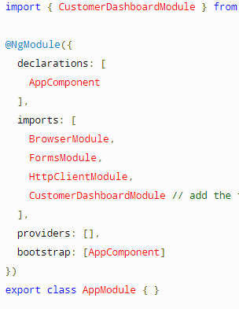
Feature Modules
Feature modules are NgModules for the purpose of organizing code.
A feature module delivers a cohesive set of functionality focused on a specific application need such as a user workflow, routing, or forms.
Everything can be done in root module, feature modules help you partition the app into focused areas.
Feature module collaborates with root module through services, components, pipe it shares.

Slide 5
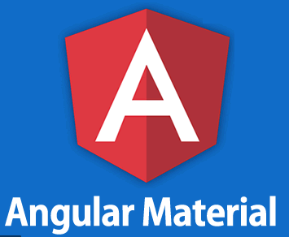
What is Angular Material?
Material Design components for Angular apps
Optimized for Angular, built by the Angular team to integrate seamlessly with Angular.
Styling
Material Design Colors
Default & Custom Themed
Components
Layout
Navigation
Form Controls
Popups & Modals
Buttons, Indicators & Icons
https://material.angular.io/

Slide 6
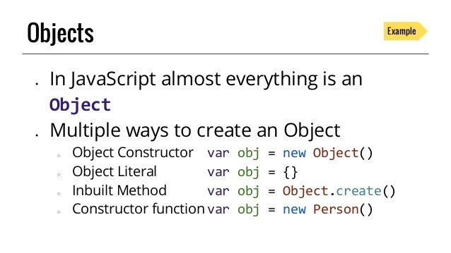
Javascript Refresher: Objects and Object Literals

Slide 7
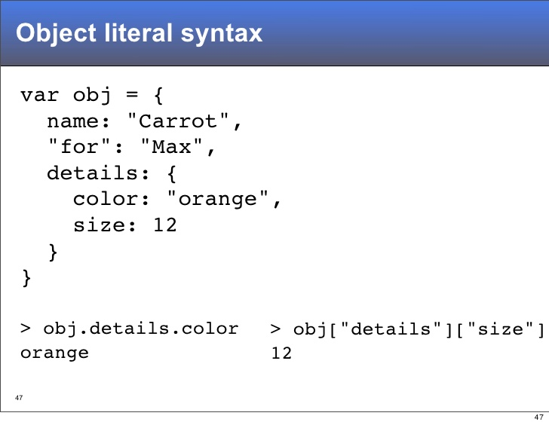
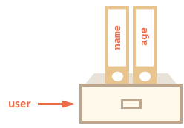
Javascript Refresher: Objects and Object Literals

Slide 8
V8 Engine

Slide 9


Slide 10

Chrome V8
V8 is Google’s open source high-performance JavaScript and WebAssembly engine, written in C++. It is used in Chrome and in Node.js, among others.
It implements ECMAScript and WebAssembly, and runs on Windows 7 or later, macOS 10.12+, and Linux systems that use x64, IA-32, ARM, or MIPS processors.
V8 can run standalone, or can be embedded into any C++ application.
https://v8.dev/

Slide 11
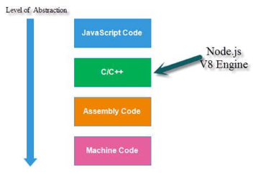
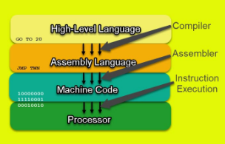
How V8 Translates Javascript into Machine Code
JavaScript in Node is converted to machine code.
Machine code is instructions that the process can understand.
V8 is written in C++

Slide 12
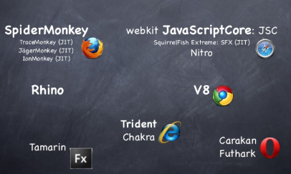
Javascript Engines

Slide 13
Node Core

Slide 14
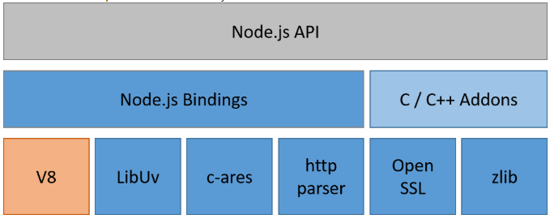
Node.js Architecture

Slide 15
Node.js Architecture cont..
libuv - libuv is originally developed to provide asynchronous I/O that includes asynchronous TCP & UDP sockets, (famous) event loop, asynchronous DNS resolution, file system read/write, and etc. libuv is written in C.
Other Low-Level Components - such as c-ares, http parser, OpenSSL, zlib, and etc, mostly written in C/C++.
Application (API)- here is your code, modules, and Node.js' built in modules, written in JavaScript (or compiled to JS through TypeScript, CoffeeScript, etc.)
Binding - basically wrappers or bridges between codes, so different languages can communicate.

Slide 16
Modules, Exports and Require

Slide 17
What is a module?
A module encapsulates related code into a single unit of code.
A module is a reusable piece of JavaScript which exports specific objects, making them available for other modules to require in their programs
Each module in Node.js has its own context, so it cannot interfere with other modules or pollute global scope.

Slide 18
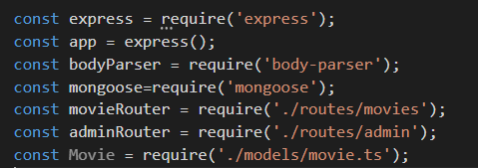
Requiring Modules
In order to use Node.js core or NPM modules, you first need to import it using require()
The require() function will return an object, function, property or any other JavaScript type, depending on what the specified module returns.

Slide 19
Three sources of Node modules
Build-in modules
Come pre-packaged with Node
Are required with a simple string identifier
var f = required(‘foo’);
A sample of built-in modules include:
fs
http
crypto
os

Slide 20

Three sources of Node modules
#2: Your Projects’ files
Each .js file is its own module
A way to modularize your application’s code
Each file is required with file system-like semantics

Slide 21
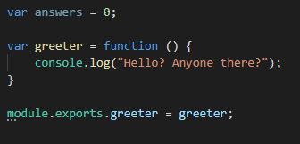
Three sources of Node modules
#2 Your Project’s files
Variables are marked for export via ‘module.exports’ - Q: Is answers variable available to caller?
- There are a few different module export patterns. https://darrenderidder.github.io/talks/ModulePatterns

Slide 22
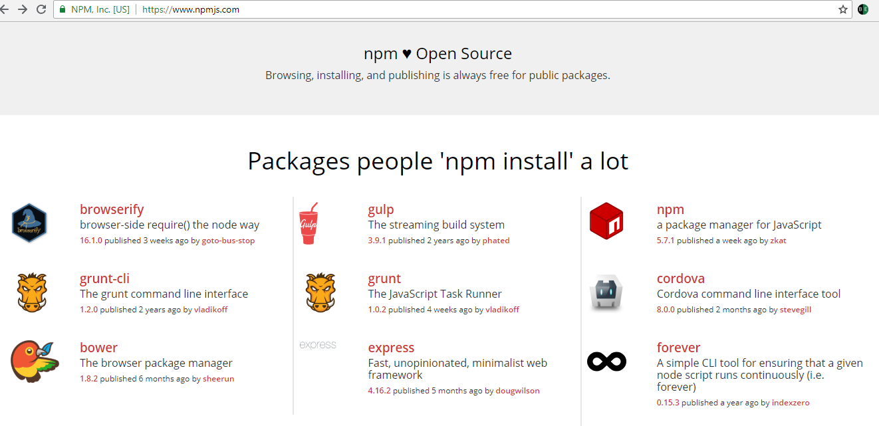
Three sources of Node modules
# 3 Third Party Modules via Node Package Manager (NPM) registry

Slide 23
Three sources of Node modules
# 3 Third Party Modules via Node Package Manager (NPM) registry
Installed via “npm install module_name” into “node_modules” folder
Are required()’d via simple string identifiers, similar to built-ins
var http = require(‘http’);
Some modules provide command line utilities as well
Install these modules with “npm install -g module_name”
Examples include: express, mocha * Note: difference between install -g and install --save

Slide 24
How do do modules really work?
Require is a function, that you pass a path too
Module.exports is what the require function returns
This works because your code is actually wrapped in a function that is given these things as function parameters

Slide 25
Events and Event Emitter

Slide 26
Event Emitters vs Events in NodeJs
Event Emitters
Node core is based on asynchronous event-driven architecture.
Emitter objects periodically emit events that cause listener objects to be called.
When the EventEmitter object emits an event, all of the functions attached to that specific event are called synchronously.
Events
An Event is something that has happened in our app that we can respond to.

Slide 27
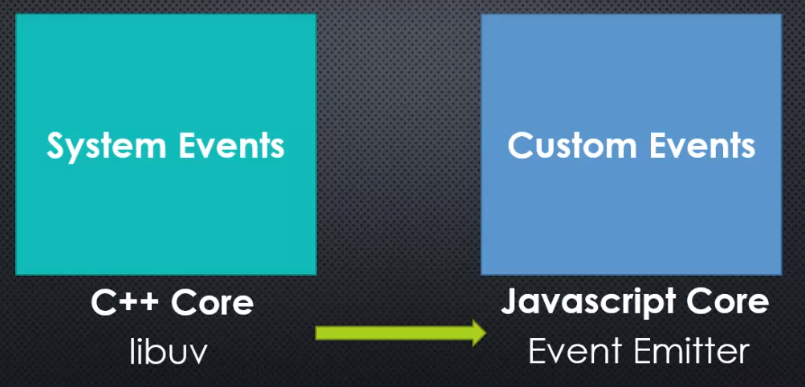
Two different types of events in Node

Slide 28
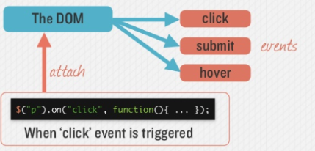
Events in the DOM
The DOM triggers Events you can listen for those events

Slide 29
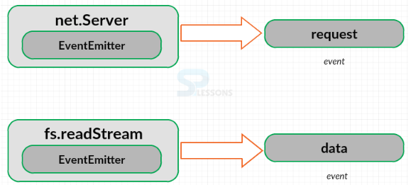
Node Emits Events
The net.Server class inherits from EventEmitter, and it emits the request event.
If user reading a file and call fs.readStream then it returns a stream which inherits from EventEmitter and will emit the data event as user reading the data out of the file.

Slide 30
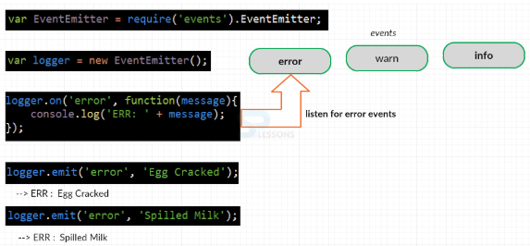
Custom Event Emitters
One can create their own Custom EventEmitter using the EventEmitter constructor

Slide 31
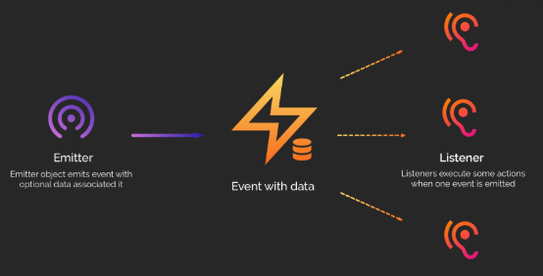
Event Emitter

Slide 32
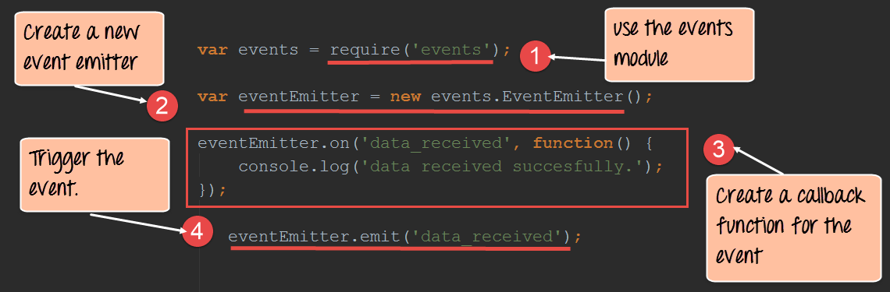
Create a new Event Emitter

Slide 33
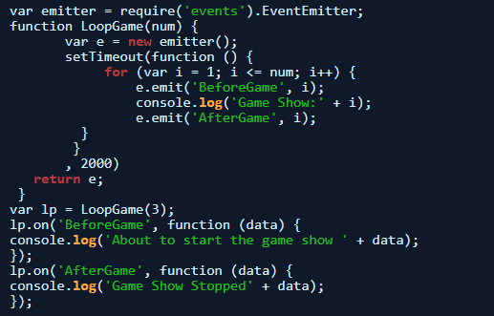
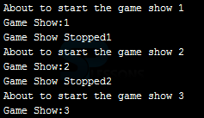
Event Emitter Example

Slide 34
HTTP and being a Web Server

Slide 35
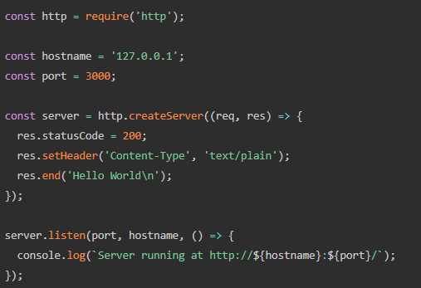
Node.js Server in minutes..

Slide 36
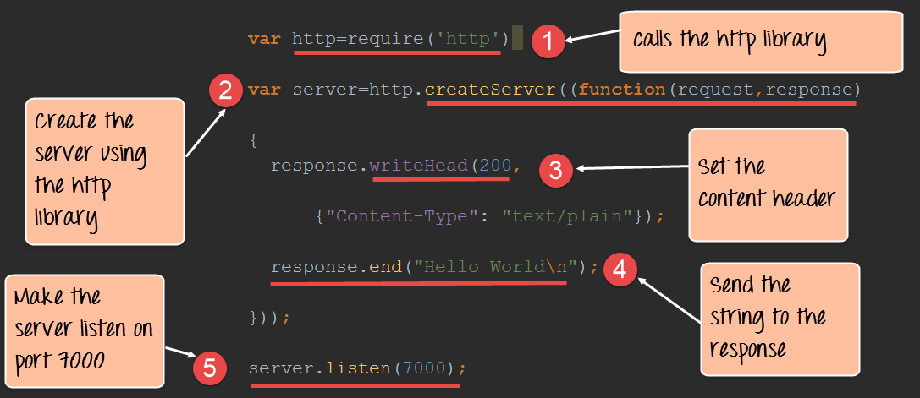
Node as a web server using HTTP

Slide 37
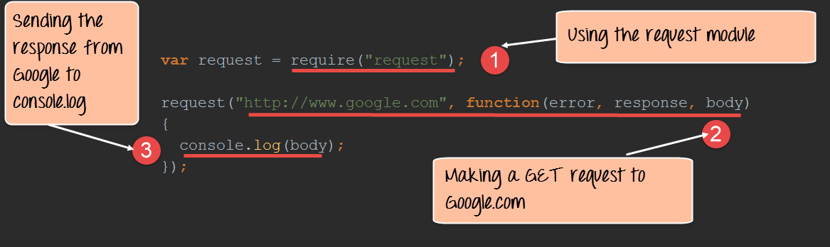
Node as Client: Handling GET Requests

Slide 38
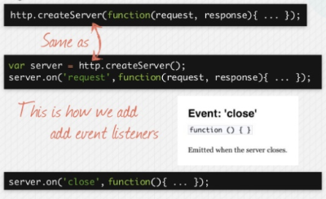
Alternate Syntax

